Slide 1
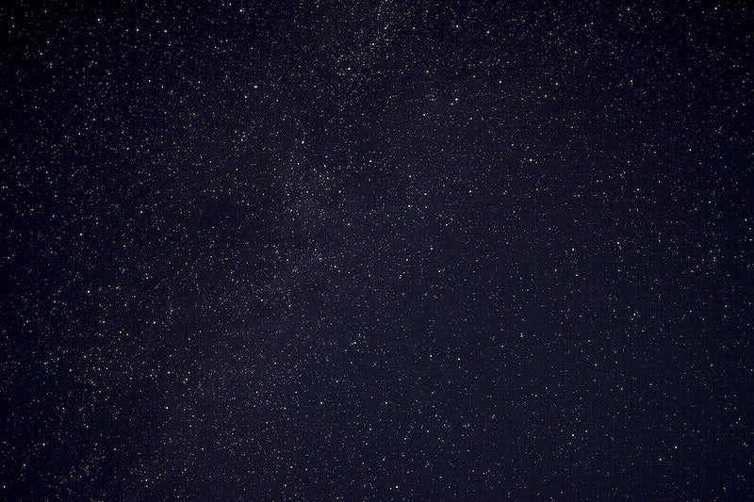
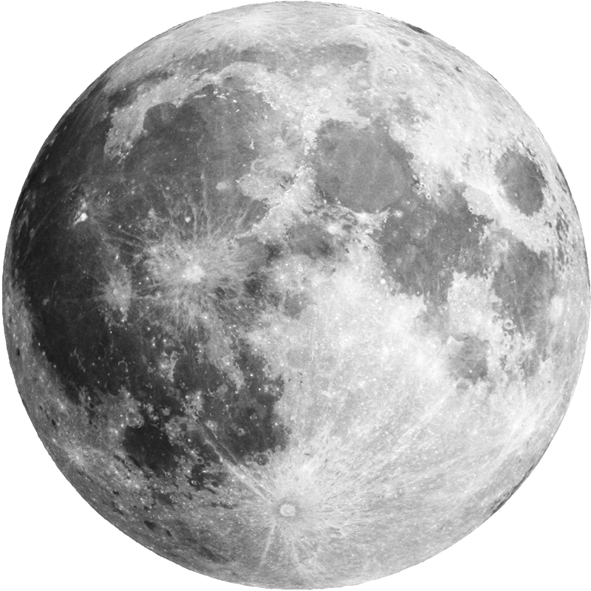
☆ it’s written in the stars ☆
Laura Barrow
Lola Newell
Mehrun-nasa Hejazi
Moses Kinganga

Slide 2
Elevator pitch/ Concept
An application that allows the user to search for their daily horoscope by inputting their name and star sign. The landing page then produces a fortune for that day along with a mood, lucky number and colour. Two GIFs are also produced based on the mood and colour for that day.
Our personal motivation behind this project was of course to showcase and practice multiple coding methods. The motivation behind the concept was to create something that was fun and unique, which is why we added the random GIF element, and for it to be a page that the user comes back to on a daily basis as the fortune changes daily.
User story - “As a user I want to be able to input my name and star sign in order to receive a personalised daily fortune containing unique and fun corresponding GIFs”

Slide 3
Process
Along with HTML, CSS and JavaScript, the following technologies were used;
- jQuery
- Bootstrap
- APIs – Rapid API (Aztro) & Giphy API
- Google fonts
- Local storage
It was possible to divide up the tasks by having various people work on them on separate days. We collaborated while one person shared the screen and other members assisted with the tasks.
Laura – JavaScript, API, jQuery
Lola – JavaScript, CSS, Bootstrap
Mehr – HTML, CSS, Bootstrap
Moses –HTML, CSS, Local Storage

Slide 4
Challenges : Retrieving API call on second html page following event listener. JavaScript function was running again awaiting event listener, therefore we had to create a second JavaScript file, for the submit button event listener only, which pushed the input into our local storage. This then enabled the other JavaScript file to be linked to the second html only with a .ready() function.
Successes: Being able to achieve a working project with contributing as a team; everything was smooth sailing, no conflict. Personal successes as an individual were; a working JS and media query, making something work from scratch, finding a solution to a problem

Slide 5
Demo

Slide 6
Directions for Future Development
Making the CSS more dynamic by using ‘em’ instead of ‘px’ for sizing elements
Including a visual effect as a mouse trail as it was our initial scope to add some visual effects and making it user friendly entertaining.
Option to share on the user’s social media website as well as the user’s inbox daily with the option of weekly subscriptions.
Adding more APIs ie a future holiday/place to visit.

Slide 7
Links
Deployed
https://lolanewell.github.io/its_written_in_the_stars/
-
GitHub repo
https://github.com/lolanewell/its_written_in_the_stars

